Slide 1
SELF PROJECT - MALLURI HEMANTH KUMAR 160040096
(ENERGY USE & TIME USE INDIAN HOUSEHOLD)

Slide 2
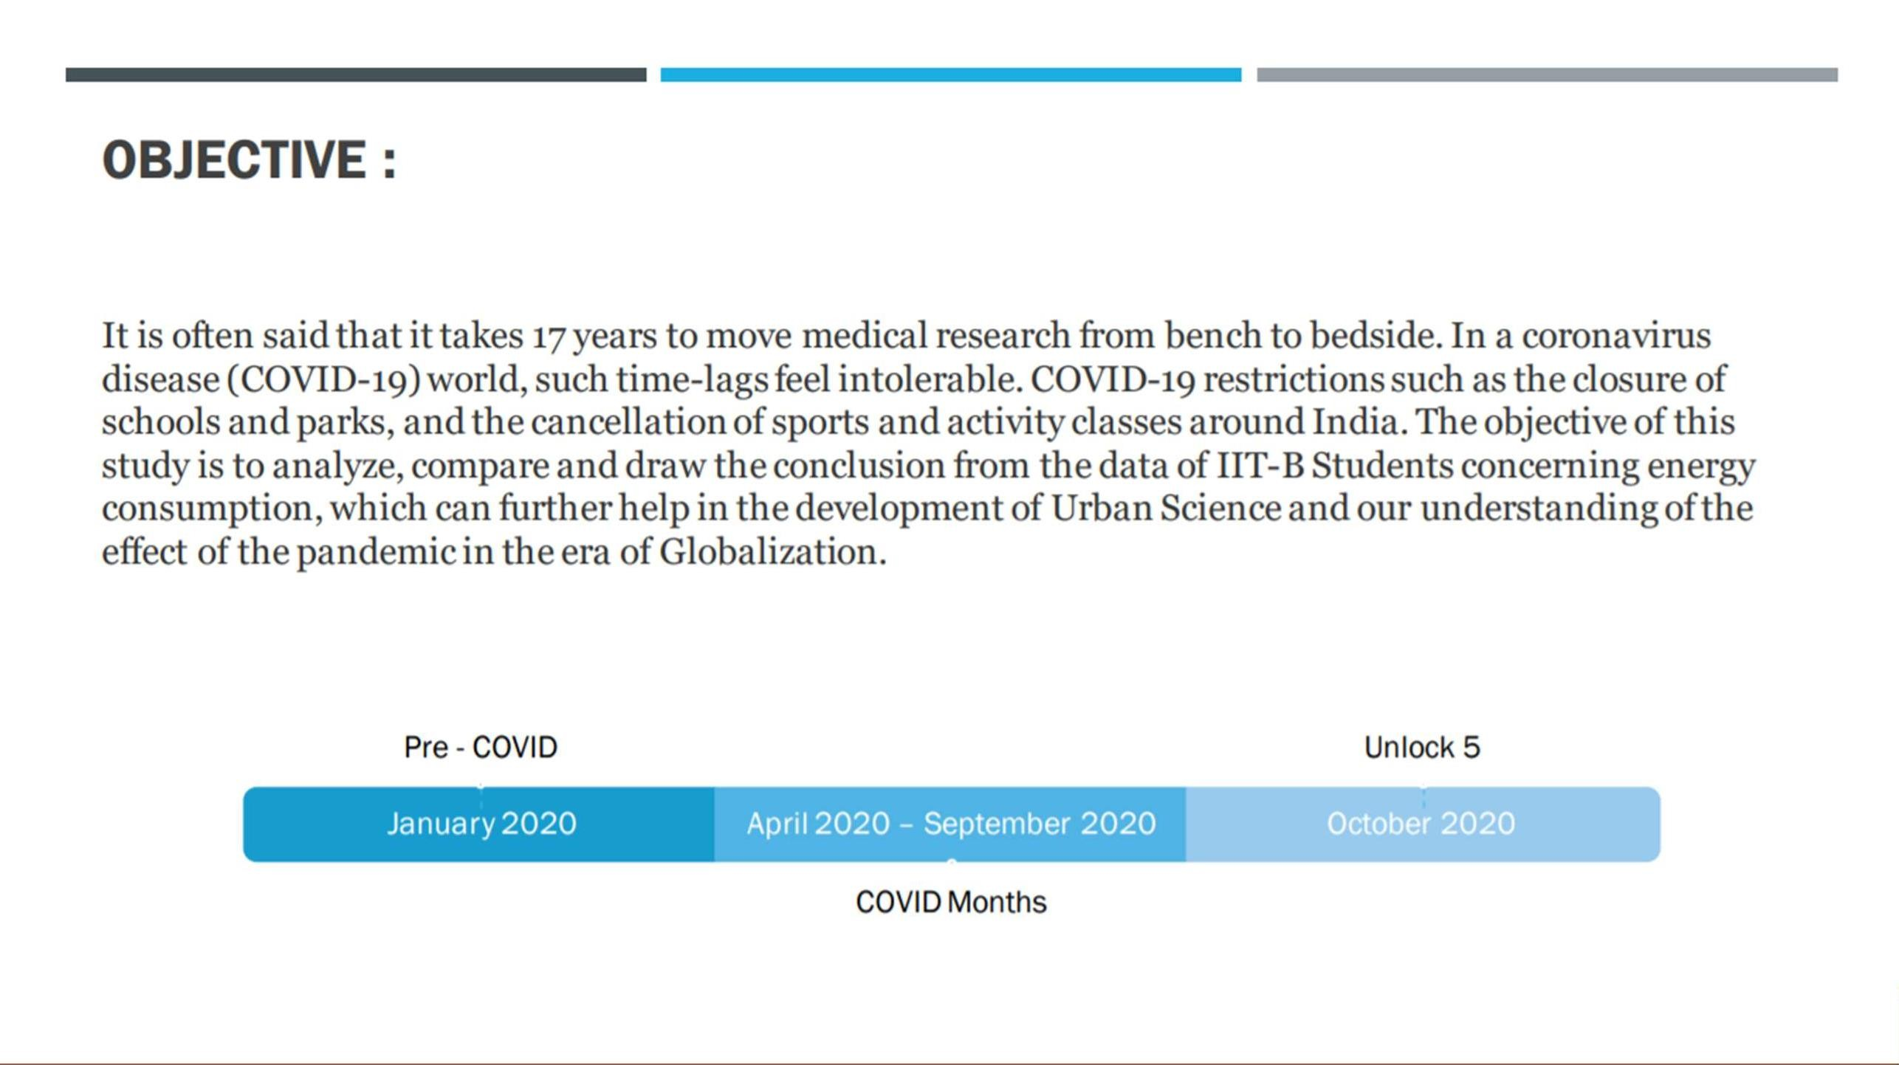

Slide 3
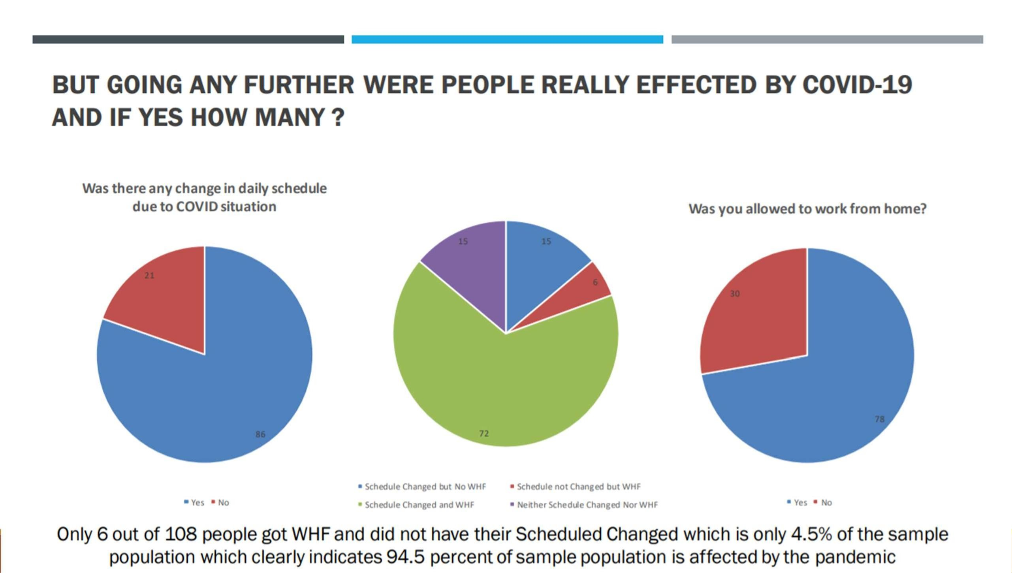

Slide 4
ANALYSIS OF ELECTRICITY UNITS CONSUMED BY HOUSEHOLDS DURING PRE-COVID AND COVID TIME

Slide 5
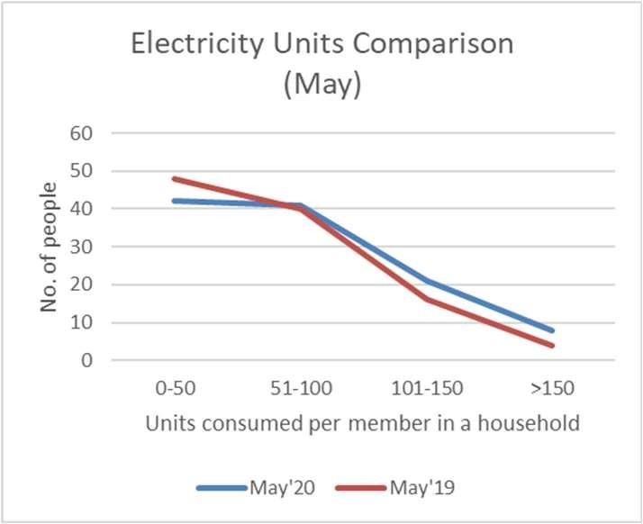
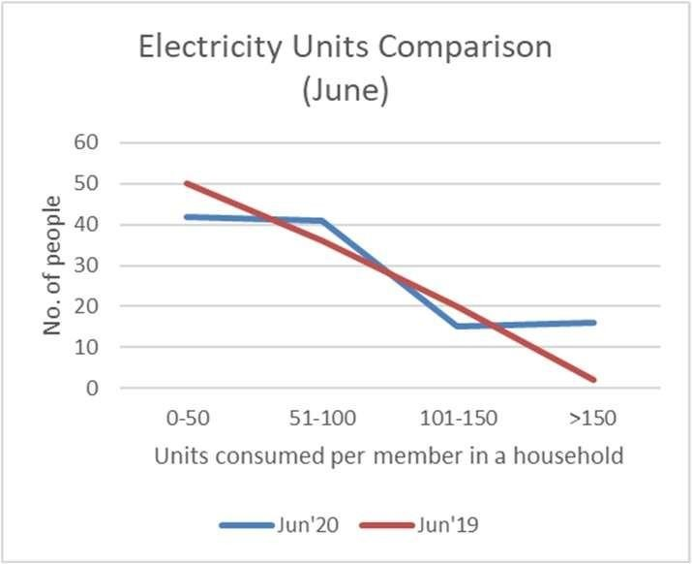
EARLY STAGES
We can clearly see from the plots that the electricity units used per member in a household has increased in 2020 as compared to 2019.
The units consumed also depend on
weather conditions so we have compared the data for the same month for different years.
We can also see that as the pandemic moved towards June, the per people unit use increased a lot in the range of
>150.

Slide 6
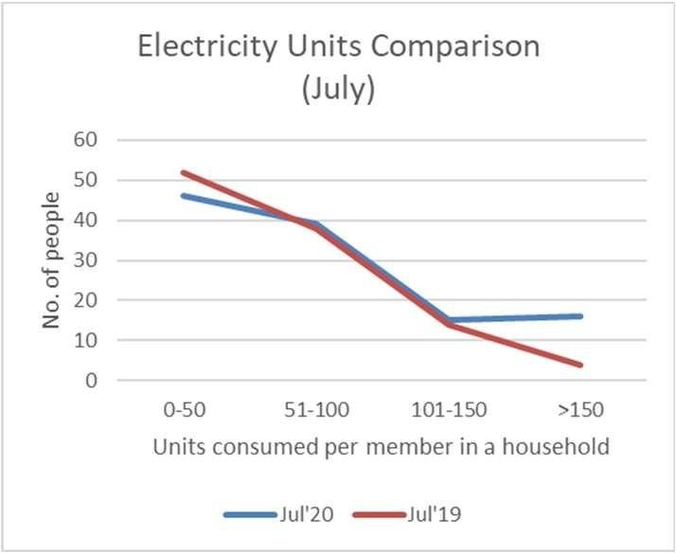
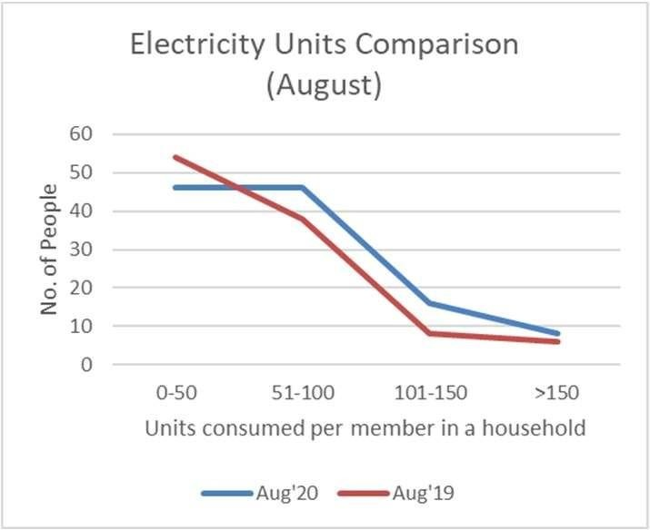
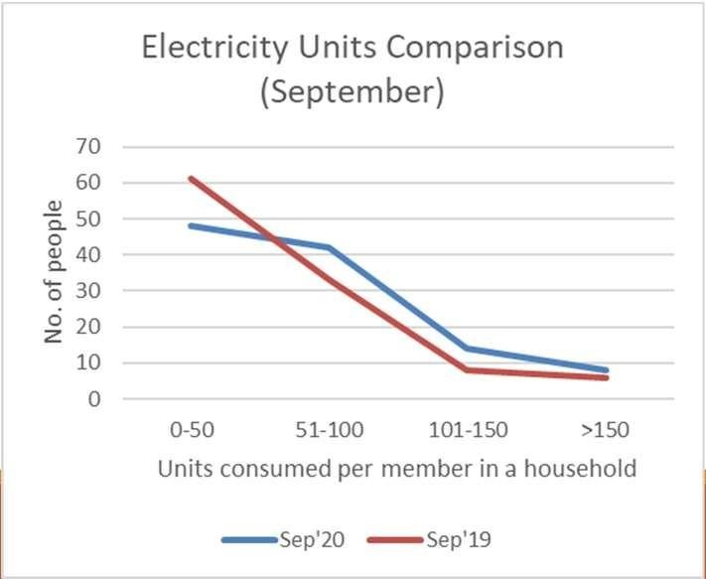
TOWARDS UNLOCK
As we moved towards unlock, again the increase of units per member reduced for the range of >150 units.
This reason behind this might be the restarting of works and increase in outdoor activities as compared to that during June-July.

Slide 7
IMPACT OF COVID-1 9 BASED ON USAGE PATTERN OF APPLIANCES

Slide 8
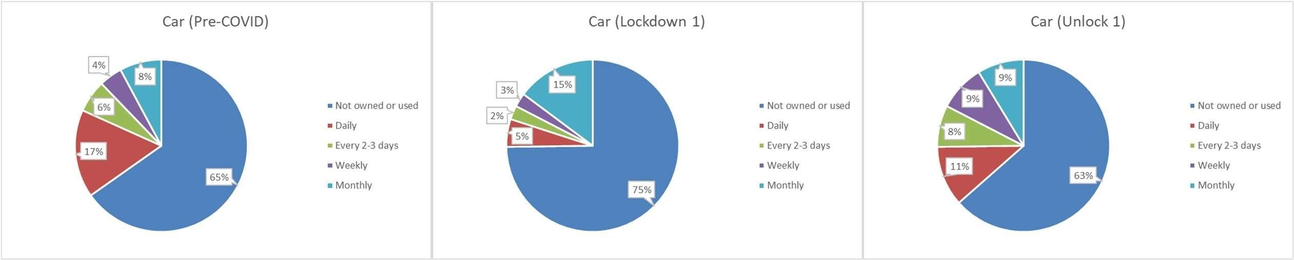
TRAVELLING
The data indicates usage pattern of respective entity and is based on the survey of 115 people.
The percentage of people NOT using (or owning) cars increased from 65% to 75% during lockdown.
This indicates that travelling longer distances has been reduced during Lockdown Phase 1.
However, the percentage again came back to 63% during Unlock 1 as the people started adjusting to the new normal.

Slide 9
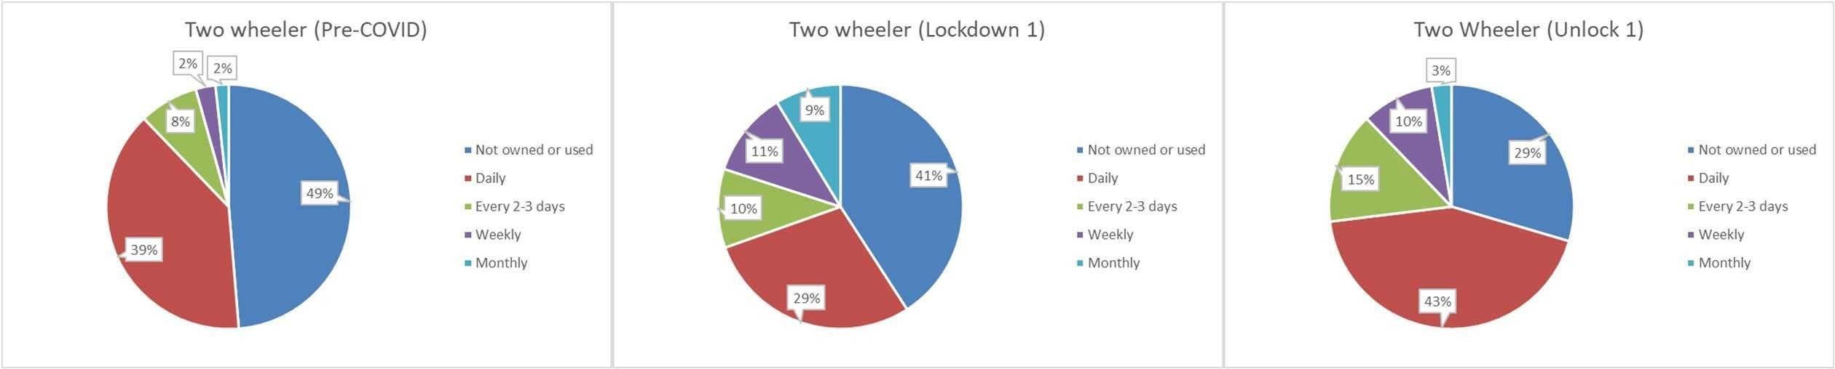
TRAVELLING
The data indicates usage pattern of respective entity and is based on the survey of 115 people.
People kept on using two wheelers but the usage became less frequent during Lockdown 1.
For fulfilling daily needs, people used two wheelers only when necessary.
The daily use increased back again during Unlock 1 as the work started back and people also started travelling a bit.

Slide 10
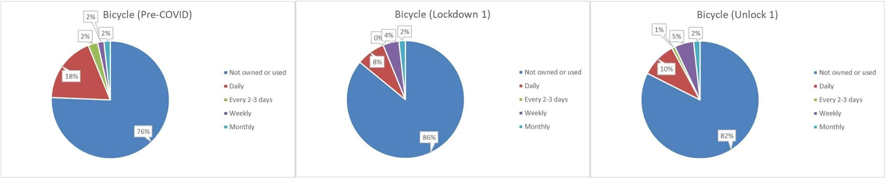
TRAVELLING
The data indicates usage pattern of respective entity and is based on the survey of 115 people.
The use of bicycles is also effected by COVID-19.
Most of the people used bicycles for exercise and travelling nearby localities.
The percentage of people not using bicycle decreased as people started doing Yoga/exercise at their home itself and also because people started using two wheelers as the %age of people ‘NOT using or owning’ two wheelers decreased a lot at Unlock 1.

Slide 11
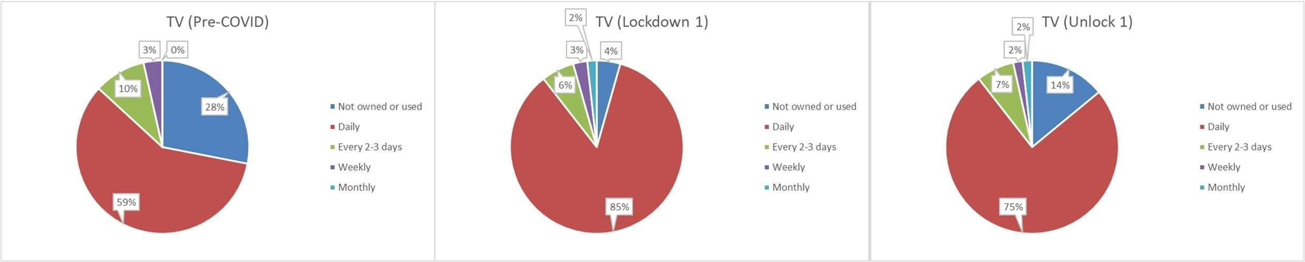
ENTERTAINMENT
The data indicates usage pattern of respective entity and is based on the survey of 115 people.
The time spent at home increased due to which percentage of people watching TV daily increased drastically.
However, percentage of people NOT using TV increased back from 4% to 14% as unlock process began and people started involving in their work/studies.

Slide 12
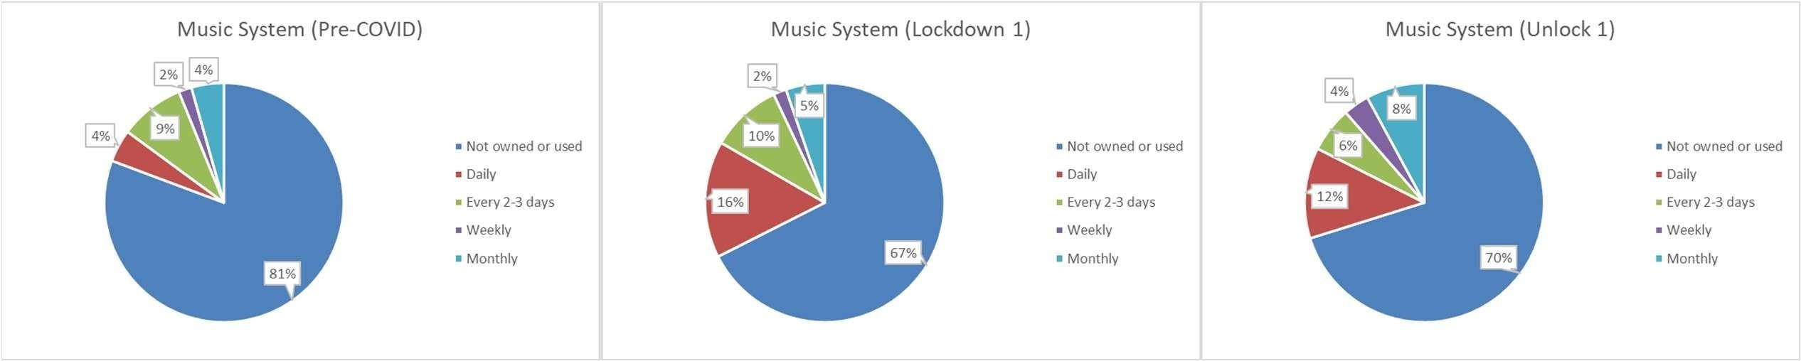
ENTERTAINMENT
The data indicates usage pattern of respective entity and is based on the survey of 115 people.
A large amount of time spent at home without any work leads to boredom and so increases the need for entertainment.
The daily use of Music System at homes became 4 times (from 4% to 16%) during Lockdown 1.

Slide 13
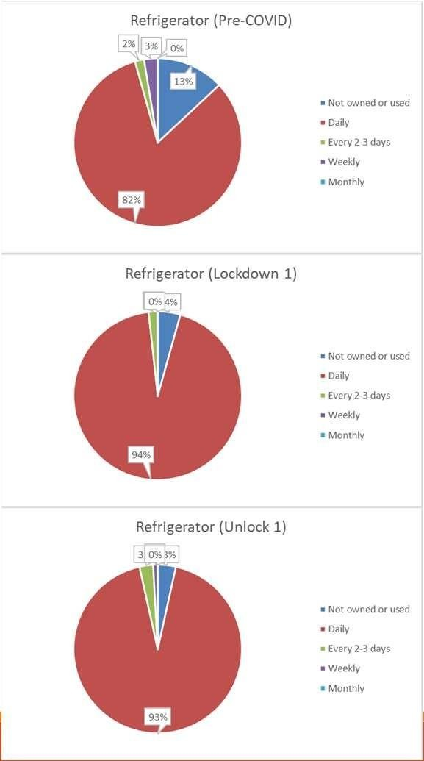
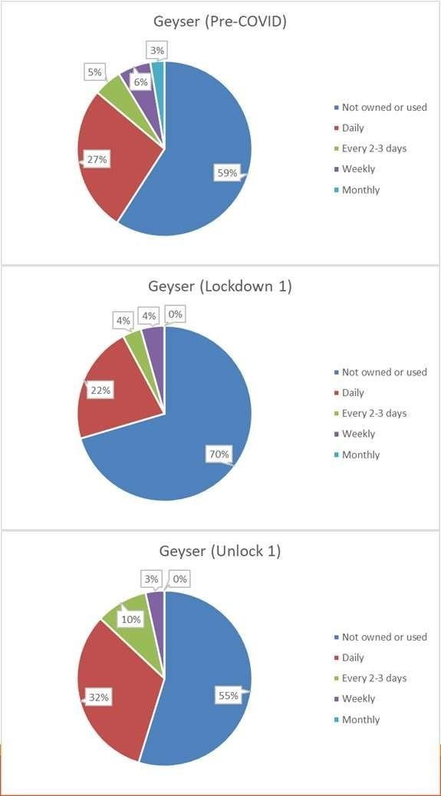
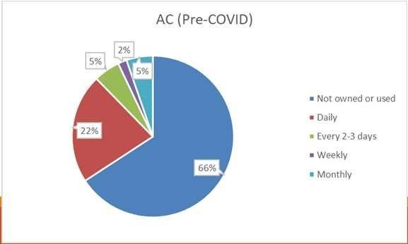
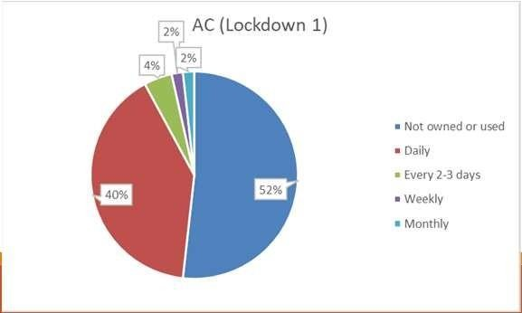
WEATHER DEPENDENT
The data indicates usage pattern of respective entity and is based on the survey of 115 people.
The daily usage of refrigerator increased during Lockdown.
The major reason must be the weather change.
But as people, not living in their hometown returned to
their home, so it also affected the usage pattern of
appliances like refrigerator, geyser, etc. which are used based on weather conditions.
The percentage of people not using geyser increased during Lockdown 1 period and the major reason should be the hot weather.
The AC usage also increased as people returned to homes.

Slide 14
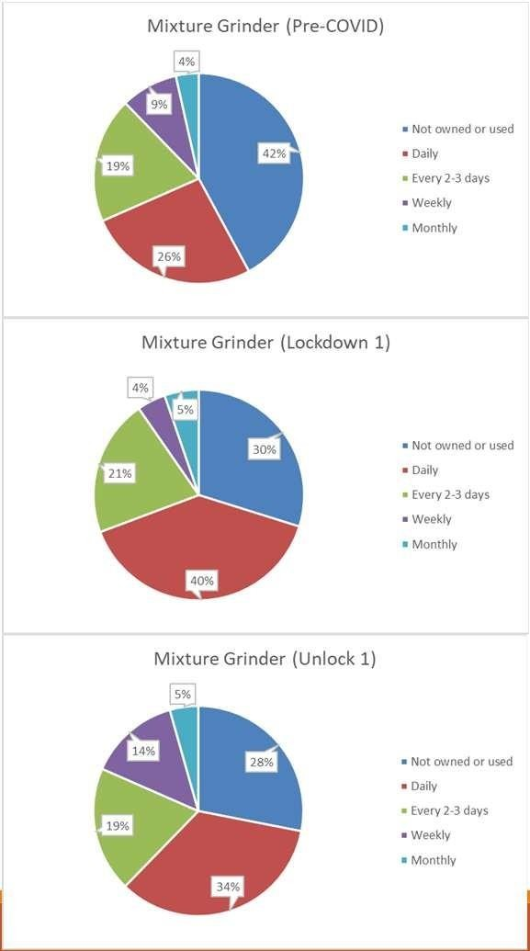
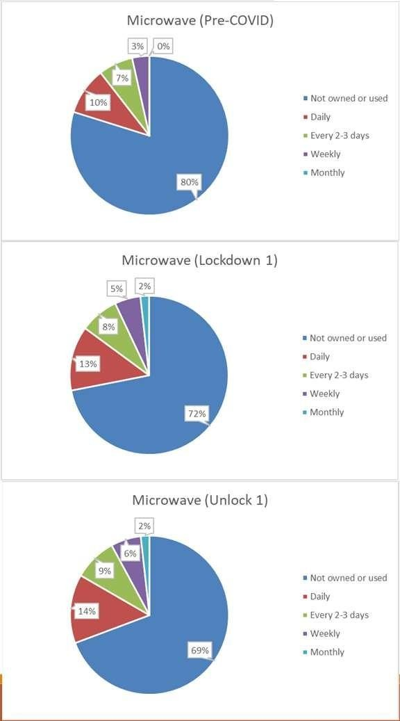
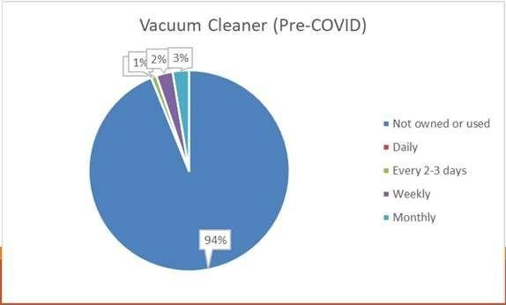
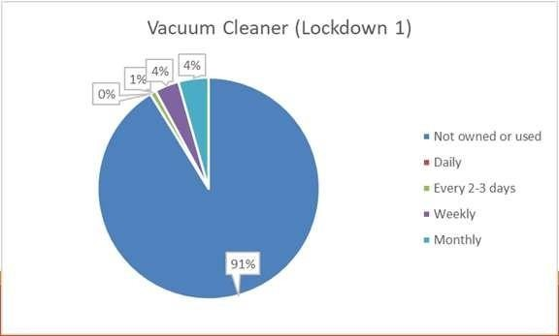
HOME APPLIANCES
The data indicates usage pattern of respective entity and is based on the survey of 115 people.
There have been mixed effect on the home appliances
usage.
Some appliances like mixture grinder, microwave, etc. have increased usage during the pandemic and others like vacuum cleaner, water filters, etc. are not affected much.
The reason for this mixed effect is that the usage of some appliances doesn’t depend on number of members in a house, but on size of house, commodities available in the
house, etc.

Slide 15
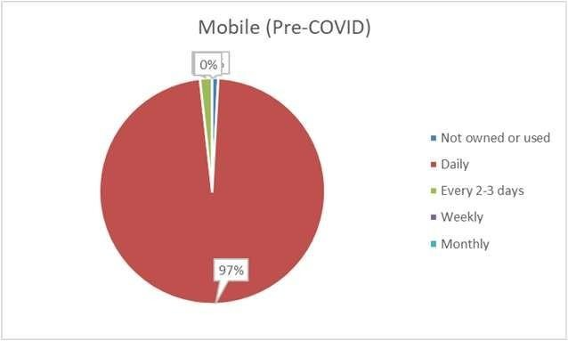
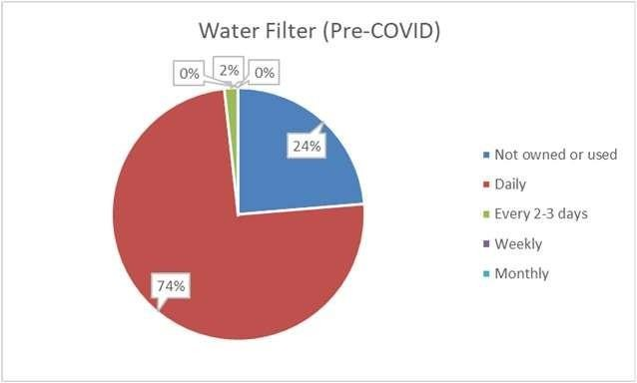
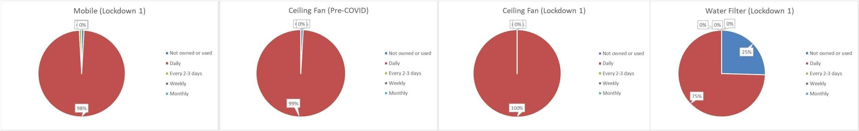
LEAST IMPACTED APPLIANCES
The data indicates usage pattern of respective entity and is based on the survey of 115 people.
Where many appliances are affected drastically due to this pandemic, there are some whose usage patterned remained the same.
These appliances include mobile phones, water filter, ceiling fan, exhaust fan, toaster, etc.

Slide 16
ANALYSIS OF TIME USE BY INDIVIDUALS DURING PRE-COVID AND COVID TIME

Slide 17
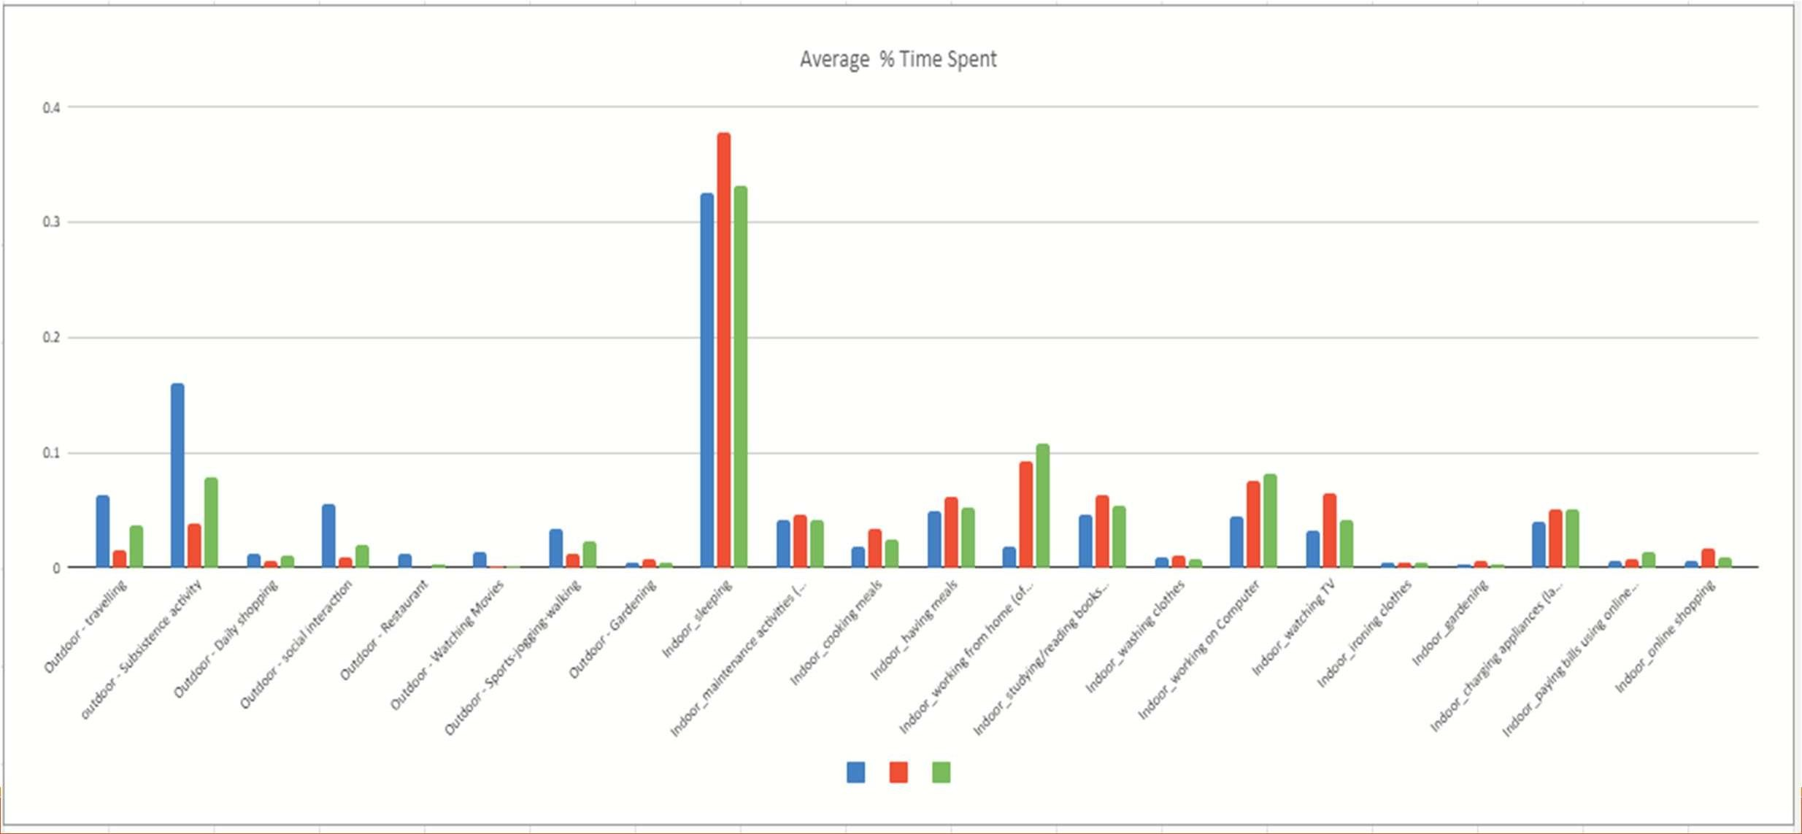
TIME USE ANALYSIS OF ALL ACTIVITIES

Slide 18
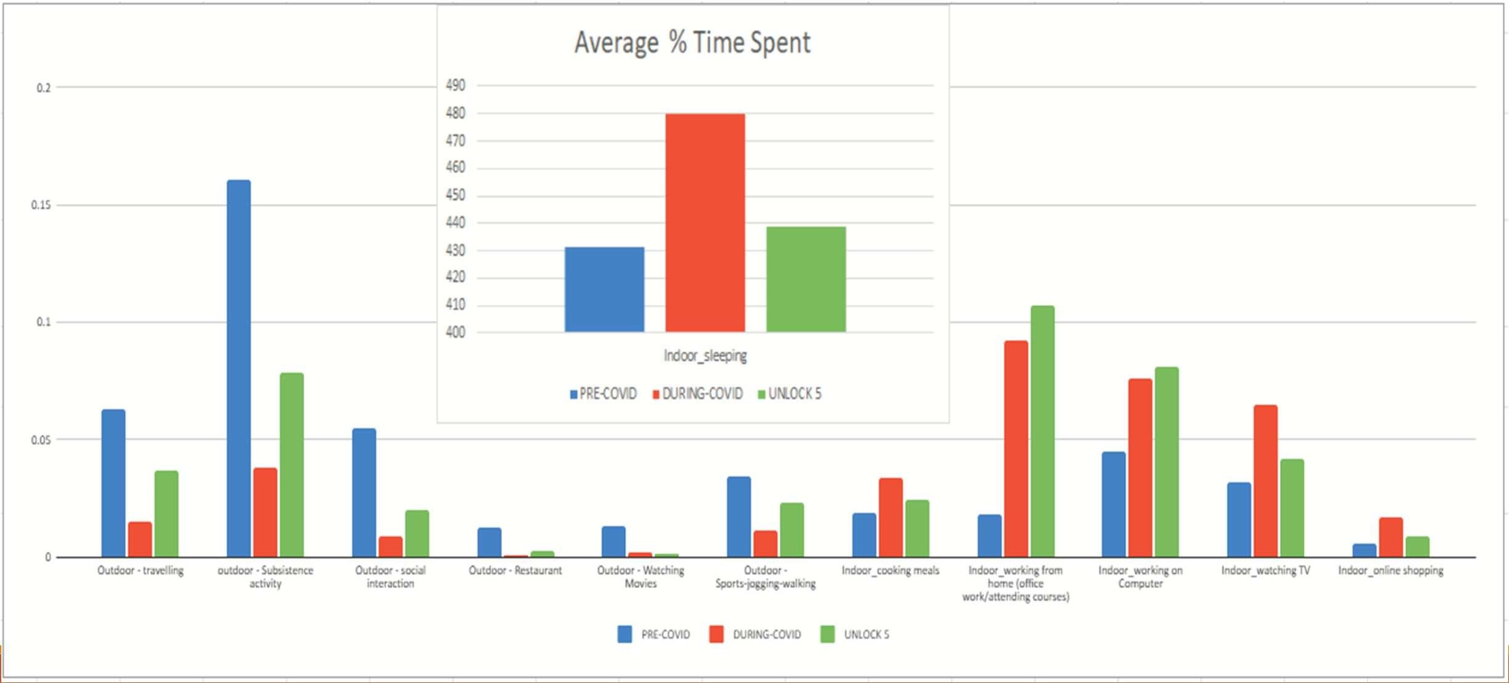
ZOOMING IN

Slide 19
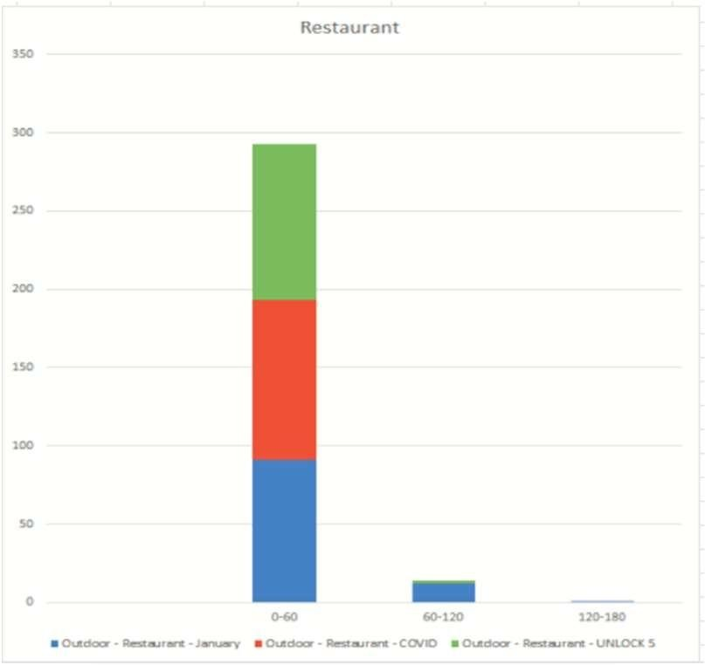
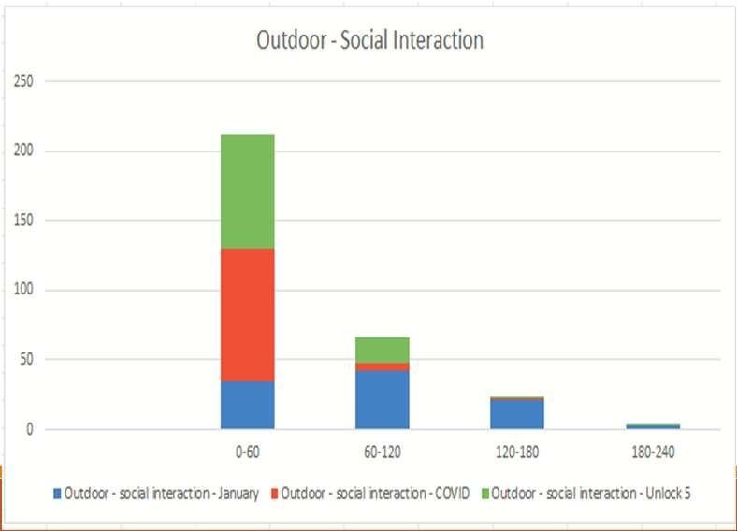
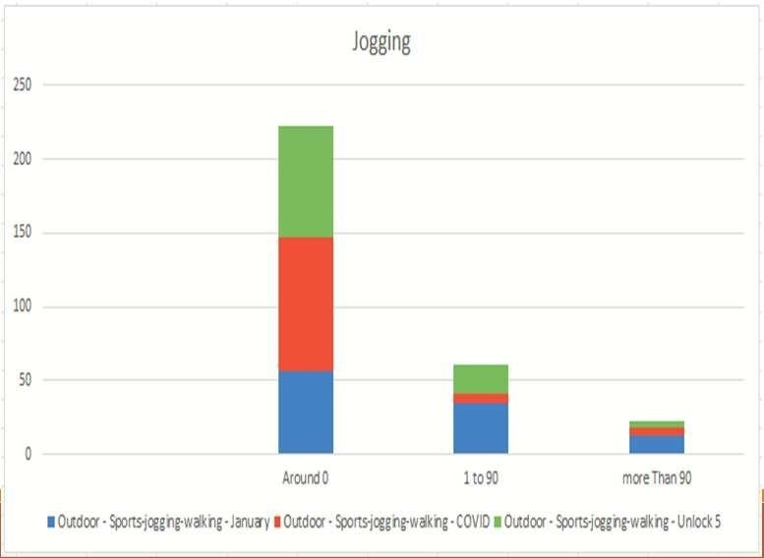
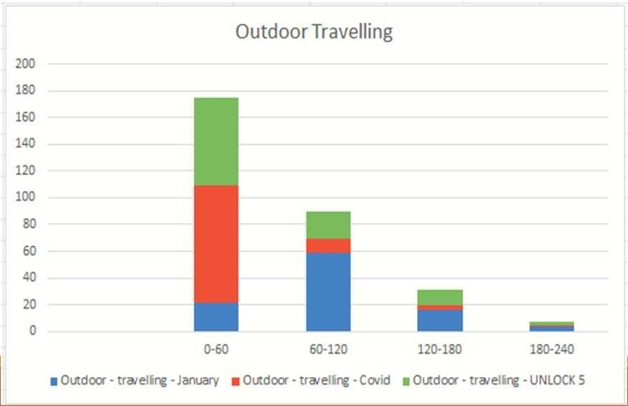
OUTDOOR ACTIVITIES
Yes we can clearly see from the previous slides that the average time spent outdoor by average person is drastically reduced during the COVID-19 and after unlock 5 also, but from the current graph we can also see how many number of people it has affected. If you look at the outdoor travelling, outdoor social interaction and Jogging Graph with time spent during 1 hour and 2 hour during COVID is drastically reduced if not none. Restaurant business is completely wiped out. And 0 minute spend is the most common number in the outdoor activities.

Slide 20
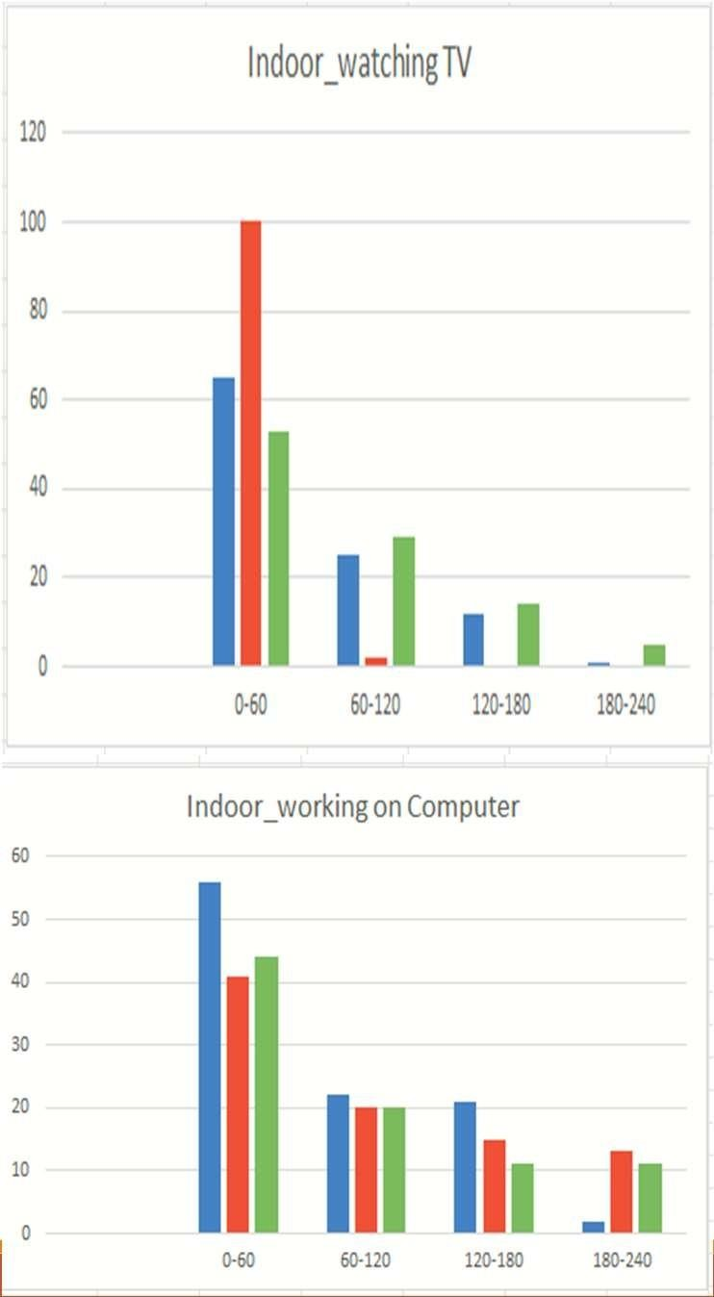
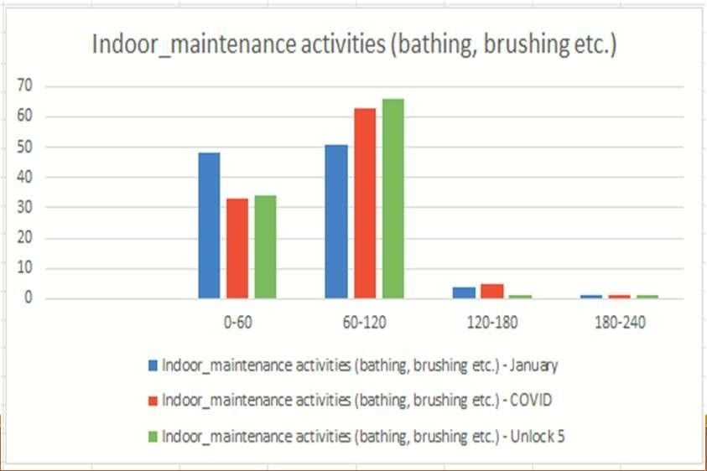
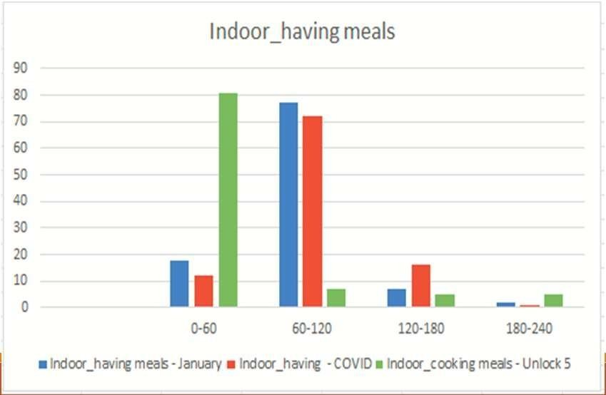
INDOOR ACTIVITIES
Apart from Indoor meals we can clearly see in the Indoor Maintenance activities, Working from Home, Watching TV and specially Online Shopping the amount of time spent by single person has increased. We clearly see some interesting data in the Indoor having means category specially the time spent by average person was drastically increased during the COVID times from 2 to 3 hours. But we clearly see that after unlock 5 most of the people are spending less than an hour having meals Indoor, this could be due to various reasons like they have become more Health Conscious or they are fed up and started eating outside more.

Slide 21
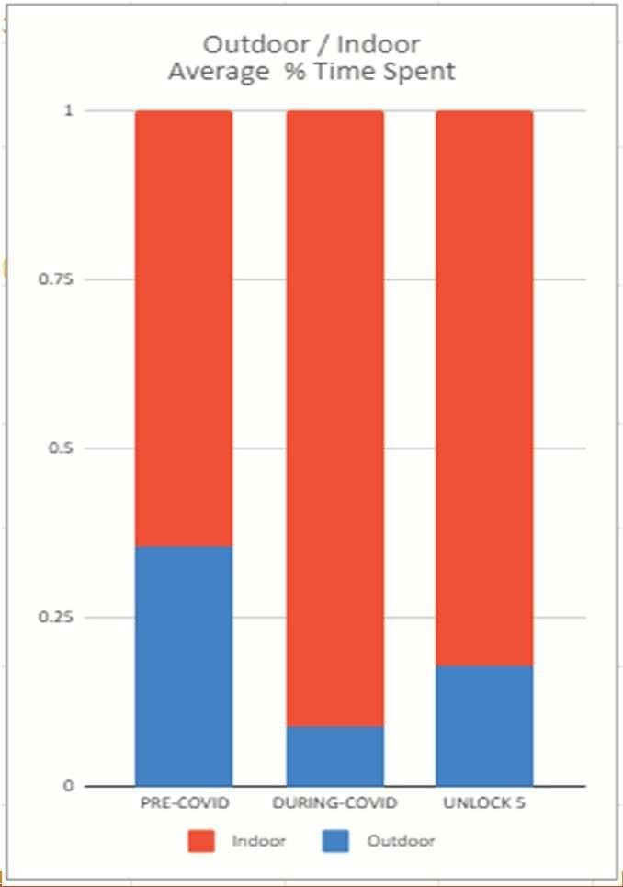
OUTDOOR ACTIVITIES V/ S INDOOR ACTIVITIES
The outdoor versus indoor results are surprising yet not surprising because of the new normal.
Average time spent by an average person Outdoor was decreased by 4 times during the COVID TIMES even after unlock 5 it only came up to a
decent percent.
For instance average time spent outdoors by average person was 36% in January it came to 9% during COVID and after unlock 5 also it only come to around 17% still half of January.
So it may still take months or years before the new normal becomes completely normal.

Slide 22
RECOMMENDE D POLICIES

Slide 23
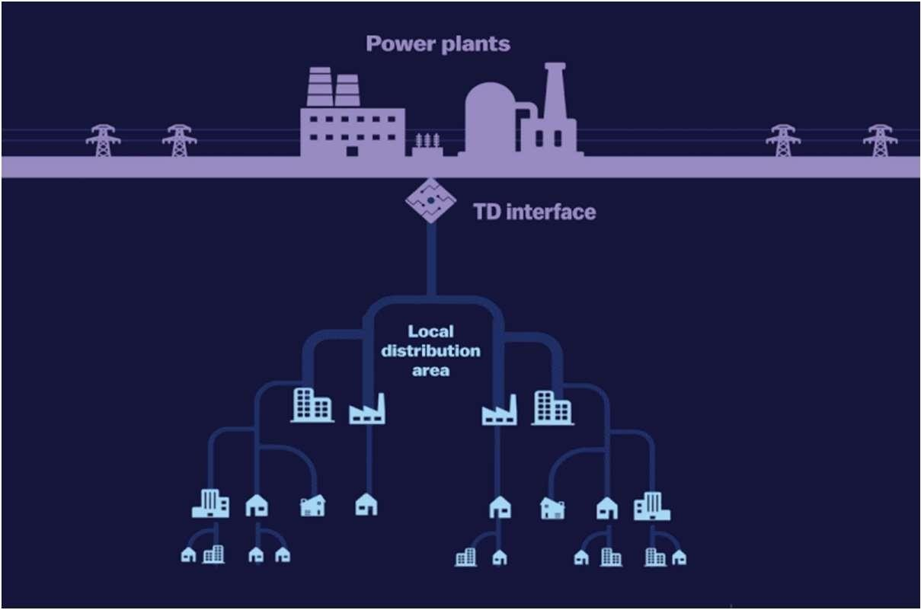
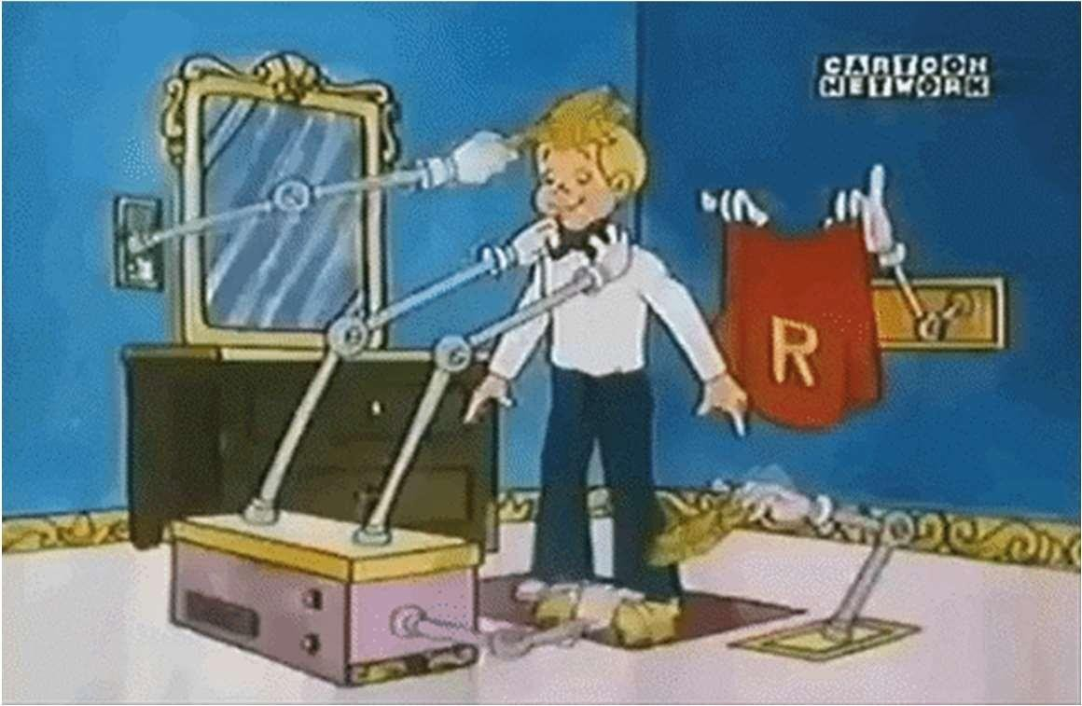
1. EFFICIENT USE OF ELECTRICITY VIS-A-VIS MORE AND CHEAPER ELECTRICITY PRODUCTION.
2 . MORE EMPHASIS ON INDOOR INFRASTRUCTURE THAN OUTDOOR INFRASTRUCTURE.
Image Source: Google Images

Slide 24
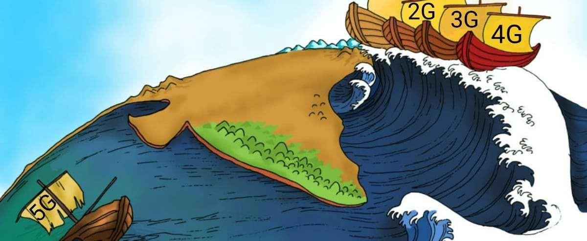
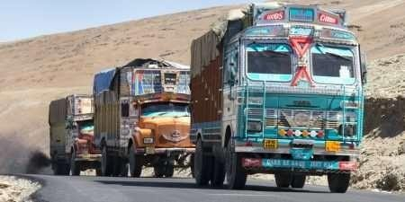
3. MORE EFFICIENT, RELIABLE WIDESPREADAND CHEAP 4 G NETWORK ( THEORETICALLY MAYBE POSSIBLY 5G) - GOVERNMENT CONTROL RATHER THAN PRIVATE MONOPOLY.
4. INCREASING AND MAINTENANCE OF SUPPLY CHAINAND SUPPLY CHAIN ANALYTICS IN INDIA.
Image Source: Google Images

Slide 25
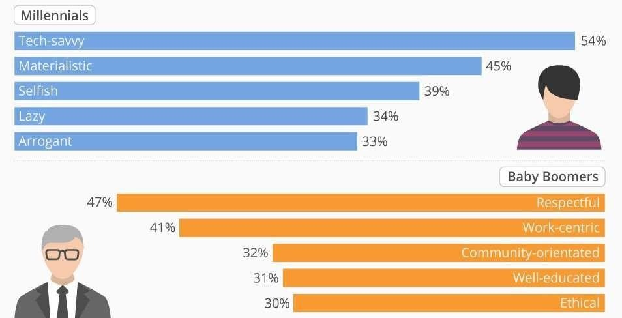
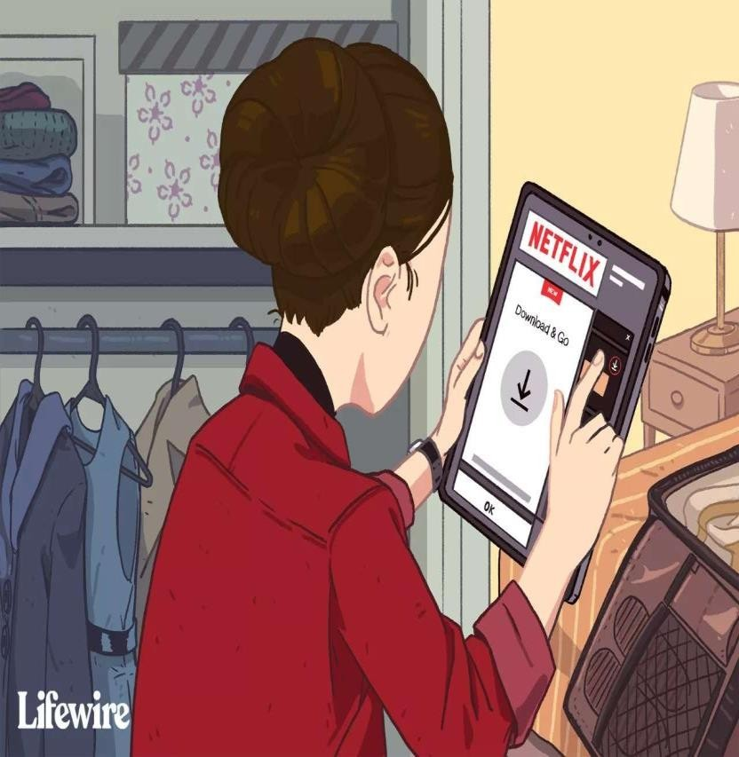
5 . SOFTENING OF AGEISM POLICIES IN WORKPLACE AS MILLENNIALS AND GEN Z ARE MORE TECH SAVVY THAN BOOMER.
6 . REVALUATION OF INDIAN MEDIA, ENTERTAINMENT AND FASHION INDUSTRY TO PRESERVE THE LOCAL CULTURE
( BOLLYWOOD) INTHE ERA OF NETFLIX WITH LOW TO NON SOCIAL INTERACTION.
Image Source: Google Images

Slide 26
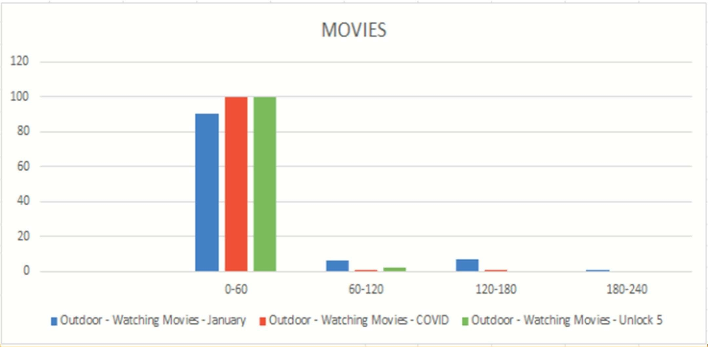
ANOMALIES IN DATA

Slide 27
THANK YOU

